Slide 1
Convex Hull a quick presentation

Slide 2

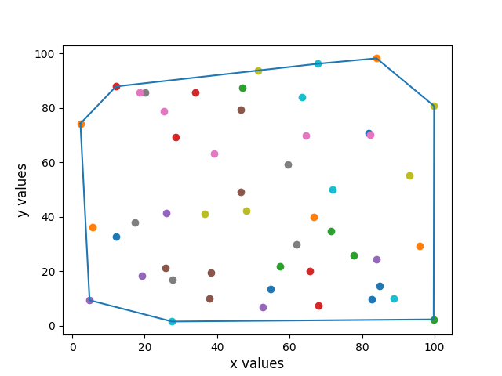
So, what is a convex hull?
Given a set of 2d-points a convex hull is a polygon so that every point in that set is either inside that polygon or part of its vertices as shown in the picture.

Slide 3
Why is it useful to produce a convex hull
Collision avoidance
If we produce an accurate enough convex hull of a car, then essentially, we have a shell of that car that we can use to avoid colliding with other obstacles.

Slide 4
How can a convex hull be produced?
There are multiple algorithms that produce a convex hull. Some of them are the following
Jarvis March
Graham Scan
Quick Hull
In this project, Jarvis March was used to compute the convex hull so let's take a quick look at how it works.

Slide 5
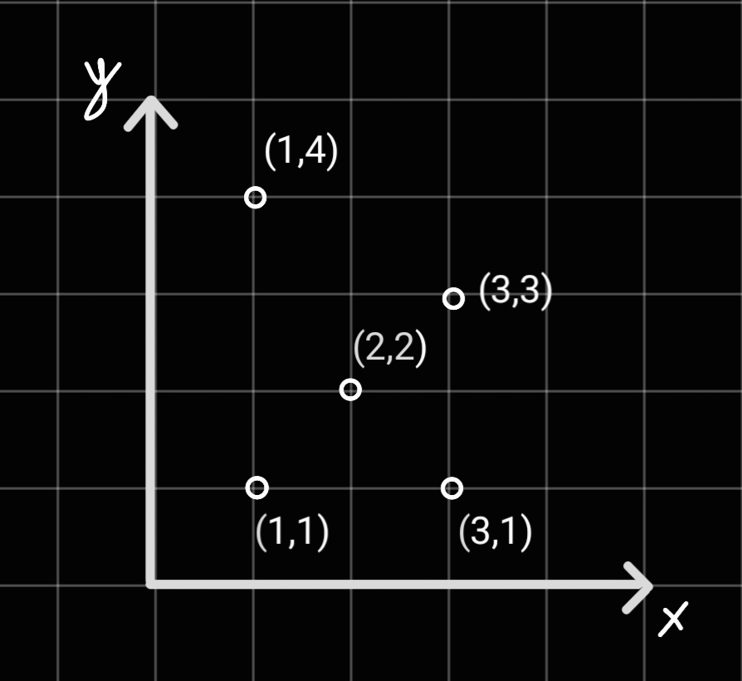
Set of points to compute convex hull

Slide 6
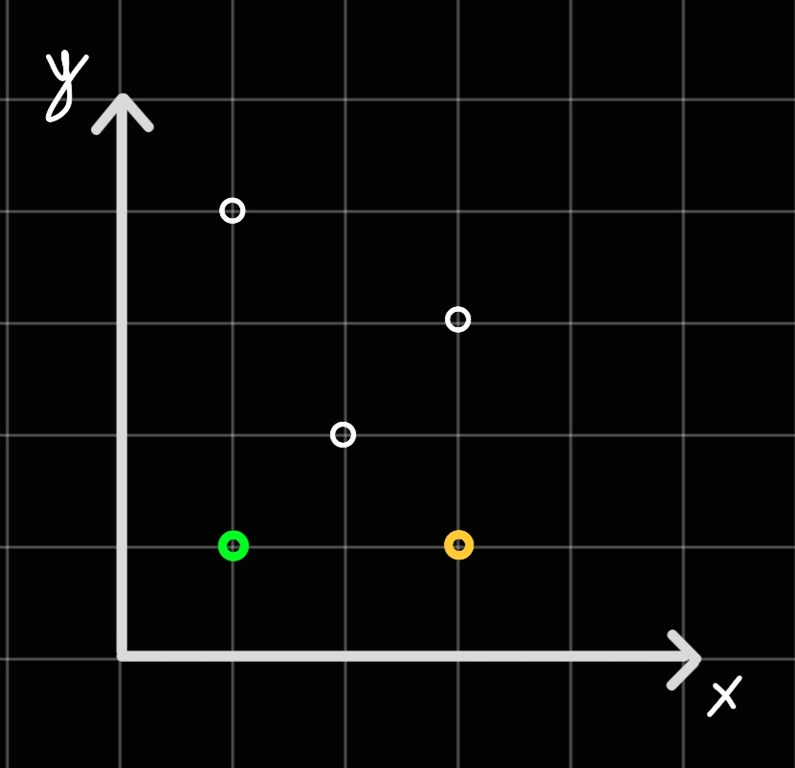
Jarvis march 1st step
Pick the point with smallest x value as the starting point(sp) [green point in the picture]
Find the next point(q) in the given set [orange point in the picture]

Slide 7
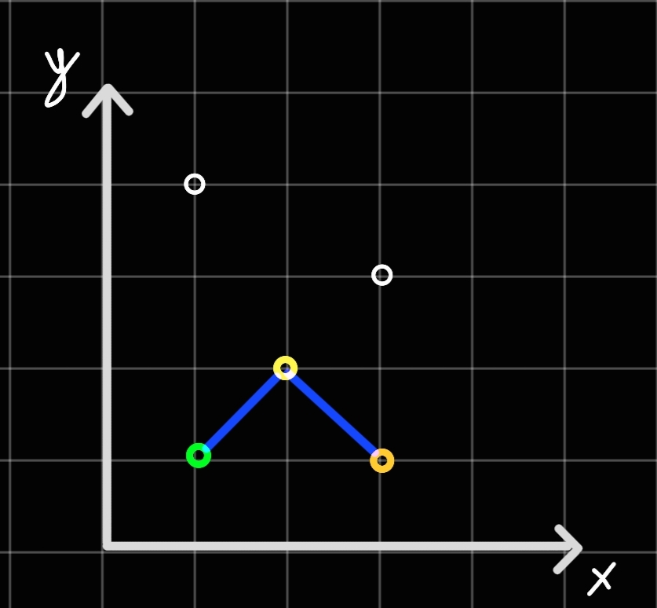
Jarvis March 2nd step
Iterate through every other point(i)[yellow point] checking every time if the turn that is produced by drawing a line from sp to I to q is left or right
If it’s right, then I becomes q, and we repeat
If it’s left, then we pick another I and check the turn
Here in our example the turn is right as shown in the picture, so I becomes q

Slide 8
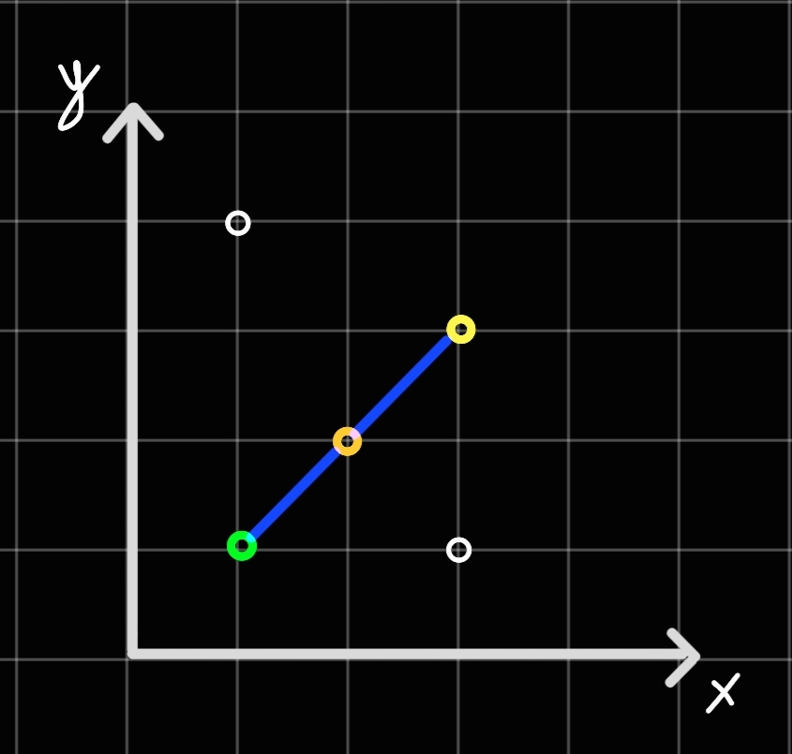
Jarvis March 3rd step
After q becomes I we pick another i(yellow point here) and check the turn.
Since there is no turn here, we set q as I in hopes of finding a turn with some other point

Slide 9
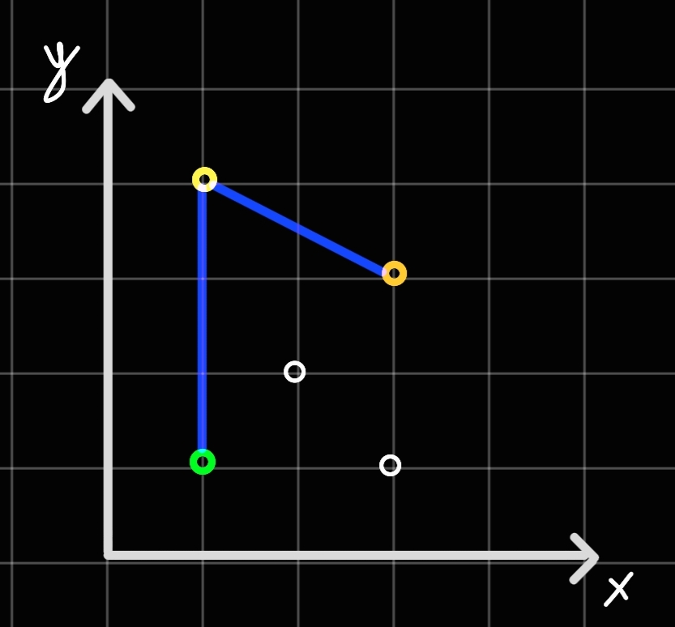
Jarvis march 4th step
After q becomes I we pick the last point available(yellow point here)
The turn is right, so we make q = I

Slide 10
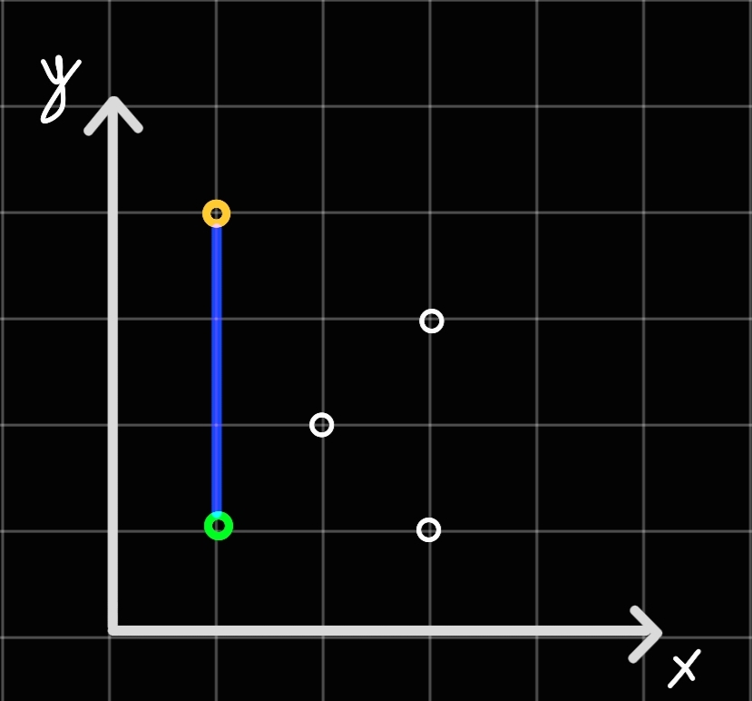
Jarvis march 5th step
Now we have iterated through every point in our set therefore our candidate point q(orange point in picture) will be part of the convex hull
We keep repeating the same steps as above until the next candidate point we can pick is our starting point. If that’s the case, then we will have constructed the convex hull of this set!

Slide 11
references
https://en.wikipedia.org/wiki/Convex_hull_algorithms
https://brilliant.org/wiki/convex-hull/

